Slide 1
ORCHIDEE – KEY PRINCIPLES FOR POC IN HOSPITAL-BASED EPIDEMIOLOGICAL SURVEILLANCE : PRAGMATIC AND CONCRETE
Federated model
Common methods, alignment with international, at least European, standards
Responsiveness to decision makers’ needs (public health objective)
Feasibility
Generalisability
Parsimonious
Reactivity
Excellent metrologic properties
Open data/information/science
Incorporating lessons from local experience

Slide 2
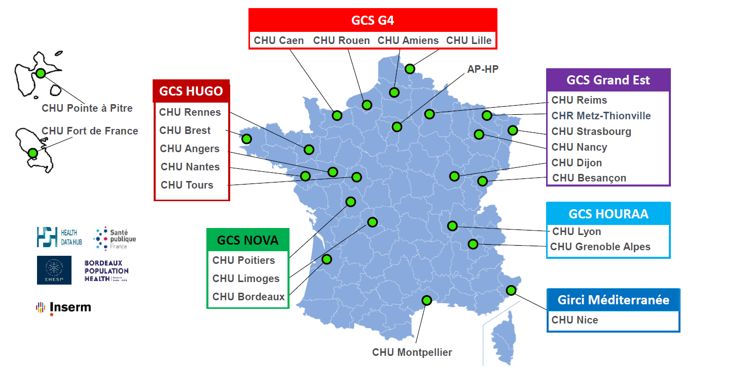
CONSORTIUM OF 29 ENTITIES, INCLUDING 25 UNIVERSITY HOSPITALS

Slide 3
ORCHIDEE – WP2 POC : CONTRIBUTION AT THE END OF THE PROJECT (4Y)
TO THE NATIONAL EPIDEMIOLOGICAL SYSTEM, INCREASED COMPLEXITY OVERT TIME
Sustainable national hospital-based epidemiological surveillance system for SARI
Sustainable national hospital-based epidemiological surveillance system for at least one other priority topic
Ability to automatically identify risk factors, determinants, or comorbidities (age, sex, social determinants, chronic disease conditions, etc.) across different hospital sectors

Slide 4
COMPOSITION OF WORKING GROUP
POC Antimicrobial resistance
Steps | Leaders/composition | Status, by Nov. 26, 2024
Co-leaders DWH : informatician(s) + epidemiologiste(s) | Stefan Darmoni / Solenn Catherine / Jean-Philippe Leroy / Julien Grosjean (CHU Rouen) | Names to be completed (EPI)
Représentatives SpF-N and SpF-R | Ghaya Ben Hmidene / Marion Opatowski (SpF-N DMI) | Names to be completed (SpF-R)
Mission-driven institutions | Catherine Dumartin (Cpias NAQ, mission SPARES) | To be determined
Contributors DWH | Sandra Fournier / Flavie Lecuyer / Jérôme Bidault (AP-HP) | Names to be completed
Experts |  | To be determined

Slide 5

INDICATOR ID TEMPLATE

Slide 6
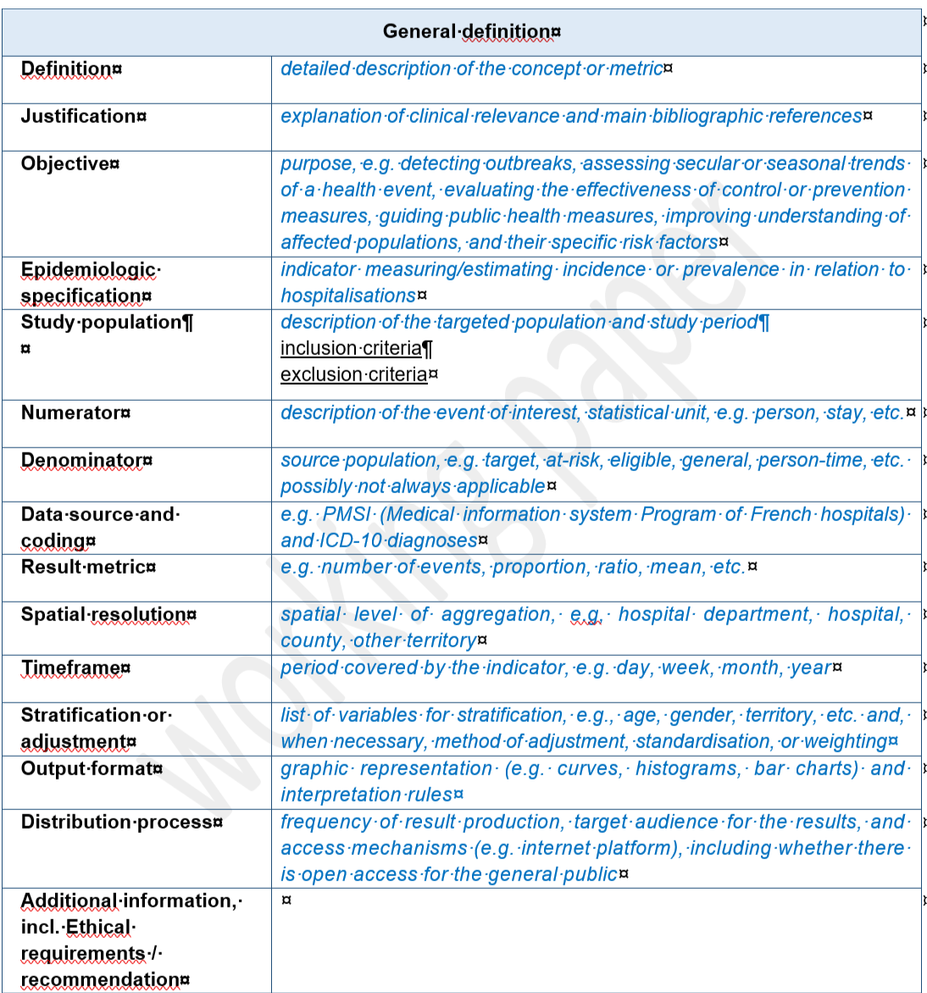
INDICATOR ID TEMPLATE : GENERAL DEFINITION

Slide 7
MONITORING ANTIBIOTIC RESISTANCE : CURRENT SITUATION AND OUTLOOK
Years 2024 - 2028
DISPENSING (based on real-life data)
CONSUMPTION (based on delivery)
2024/2025
2025/2028
STOP EXTRAPOLATING

Slide 8
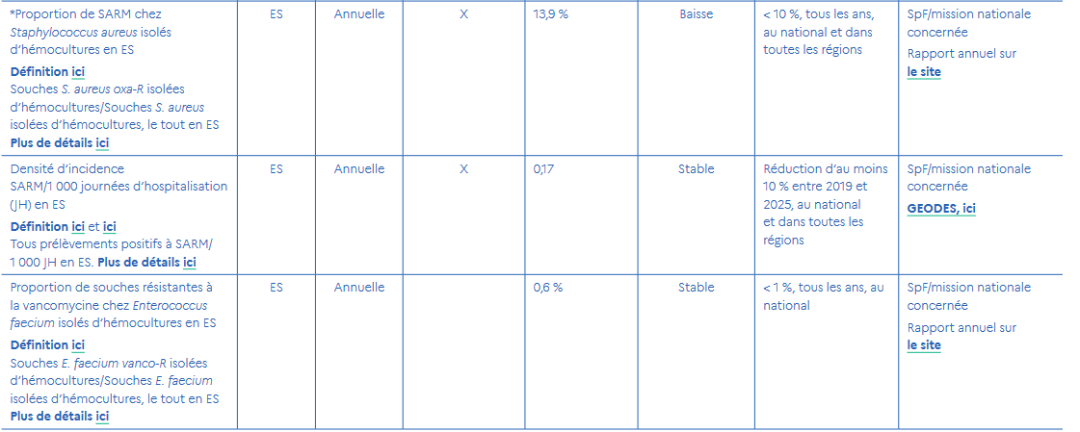
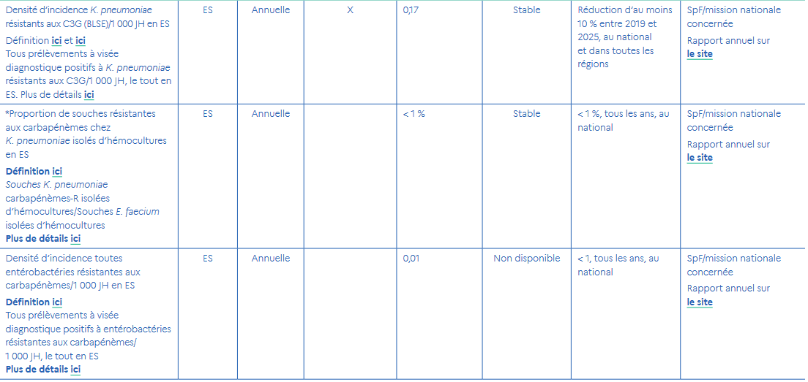
NATIONAL STRATEGY 2022-2025 foR THE PREVENTION OF INFECTIONS AND ANTIBIOTIC RESISTANCE

